Slide 3
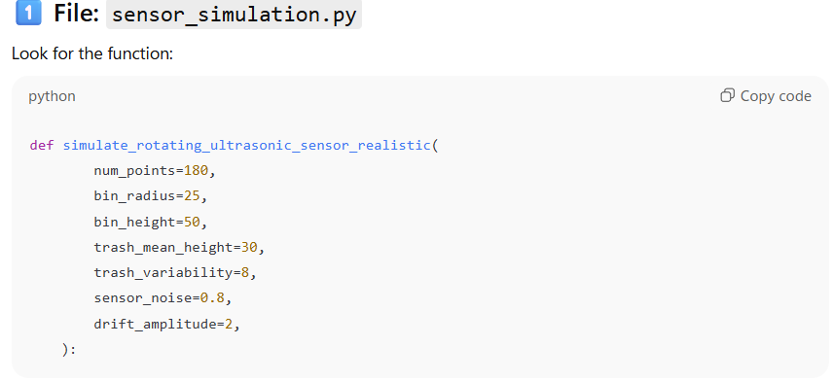
Trash Simulation Paremeters

